Slide 1
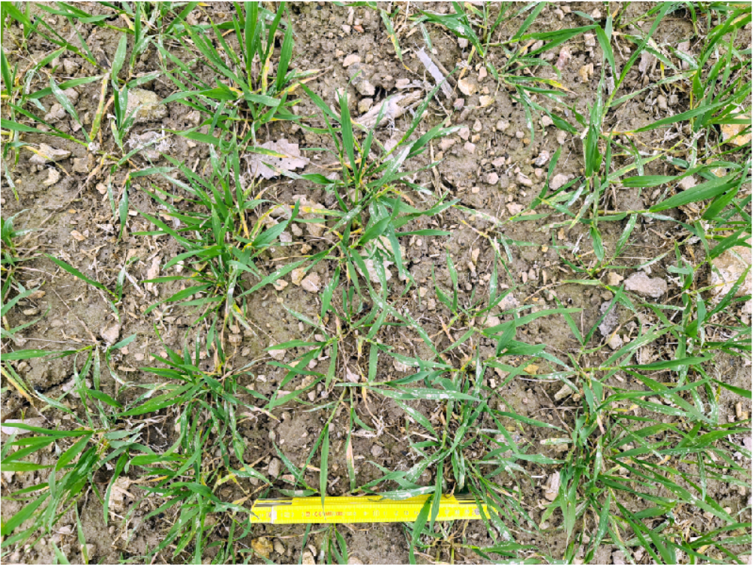
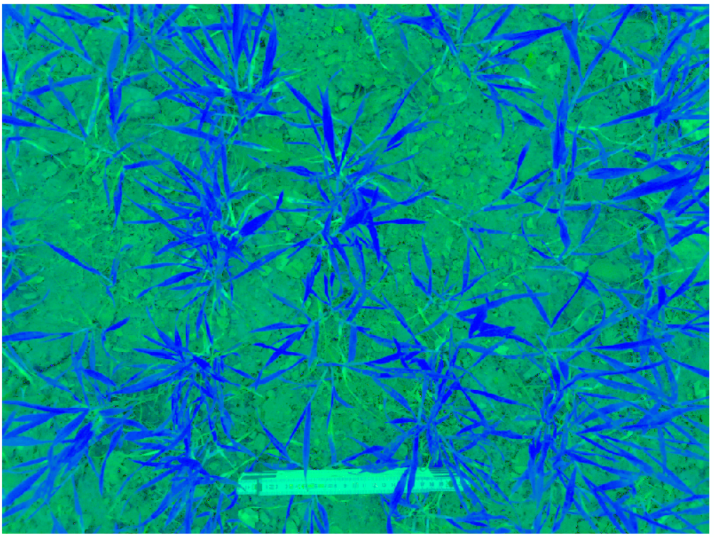
Different Feature Spaces
RGB
HLS
Hue Lightness Saturation

Slide 2
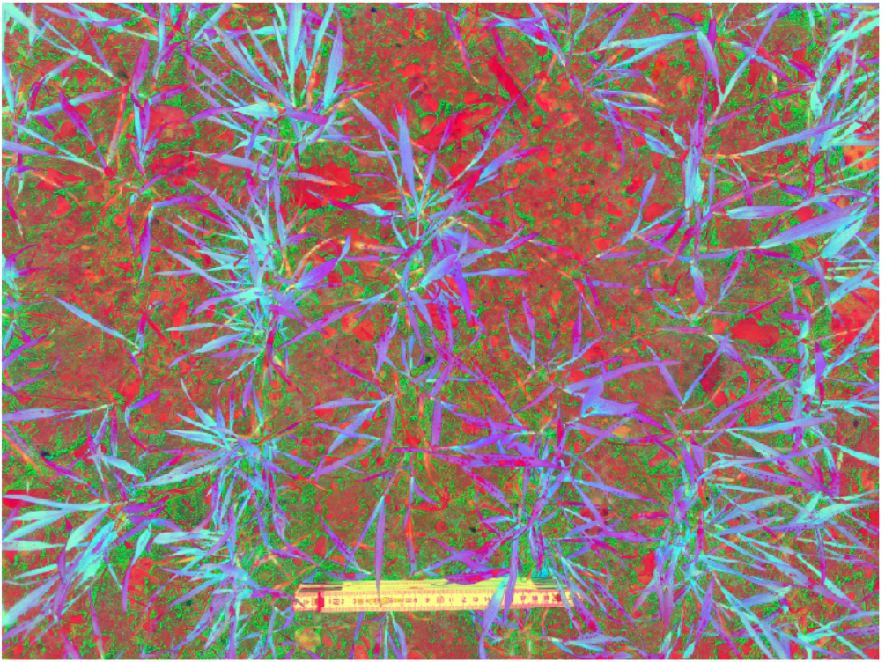
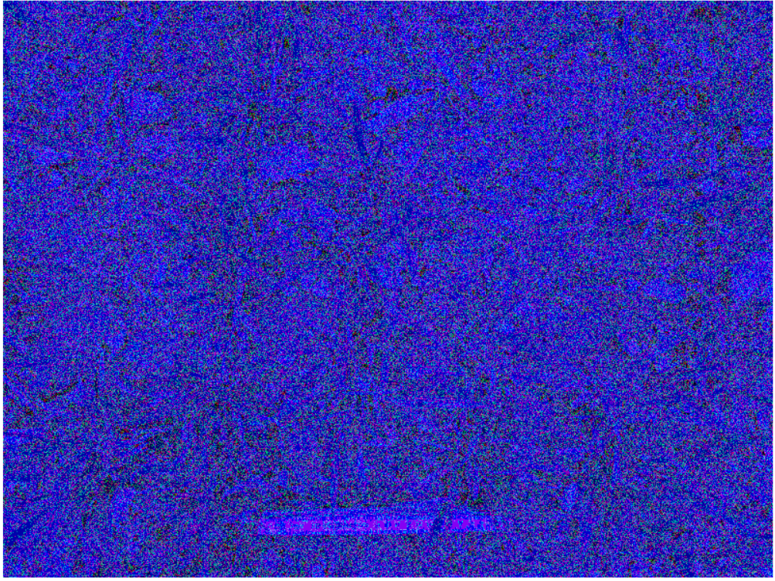
Different Feature Spaces
HSV
YIQ
Hue Saturation Value

Slide 3
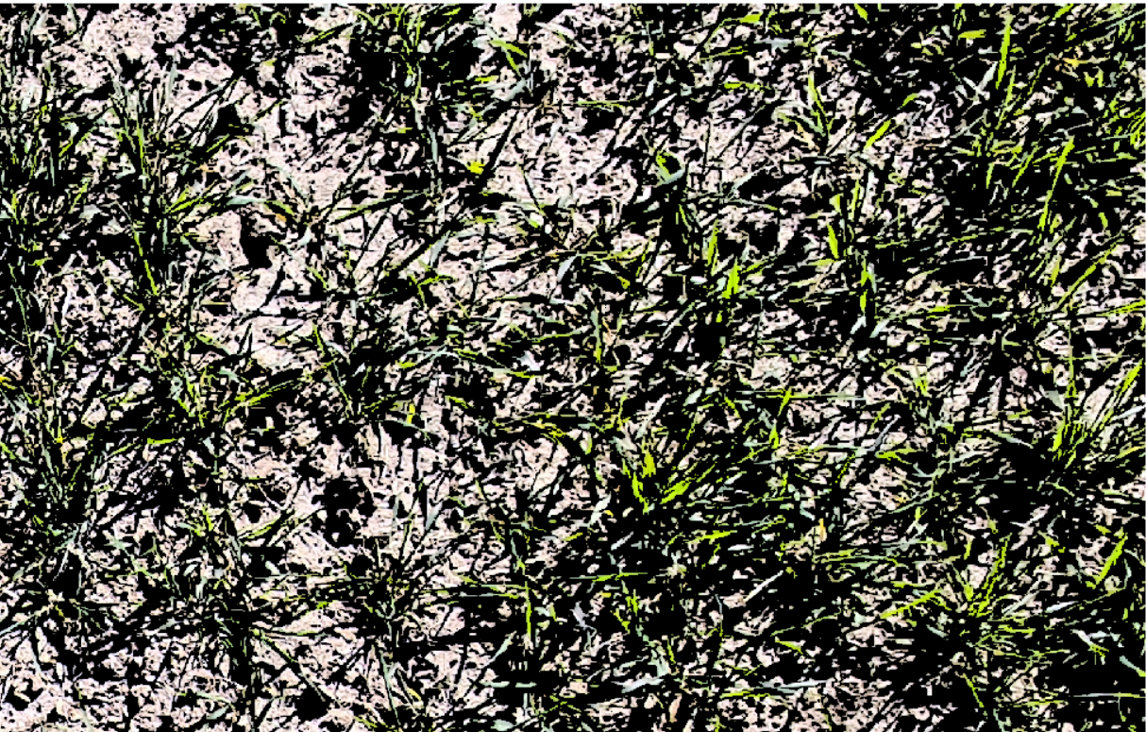
RGB space, 2 crisp clusters (Kmeans, not fuzzy)
Clustering using RGB space can not separate brighter vegetations.
There is also a misidentification of shaded areas as vegetated regions.
Detected areas as vegetation
Overlaid on RGB

Slide 4
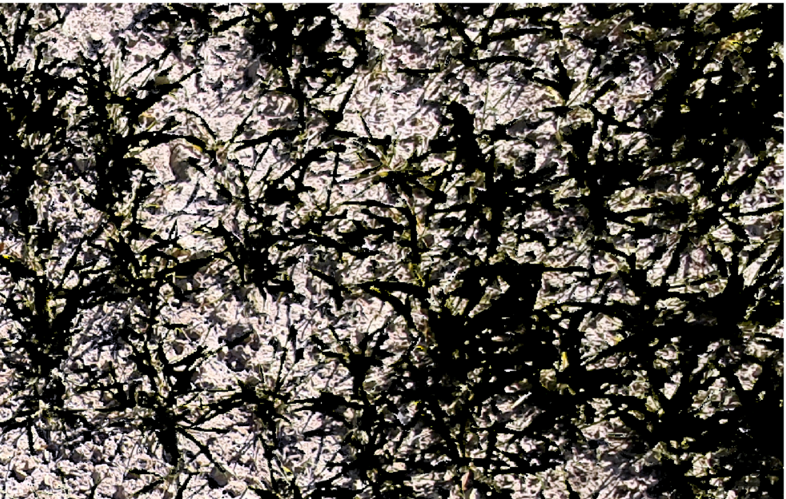
HLS space (Hue Lightness Saturation), 2 crisp clusters (Kmeans, not fuzzy)
HLS space not only clusters vegetations correctly, but also there is substantial misidentification of shaded areas as vegetated regions.
Detected areas as vegetation
Overlaid on RGB

Slide 5
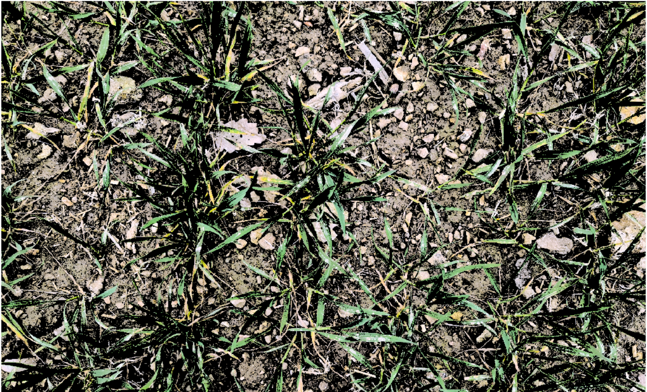
RGB space, 2 crisp clusters (not fuzzy)
The same results as previous one even when the camera get closer to the bare soil.
Detected areas as vegetation
Overlaid on RGB

Slide 6
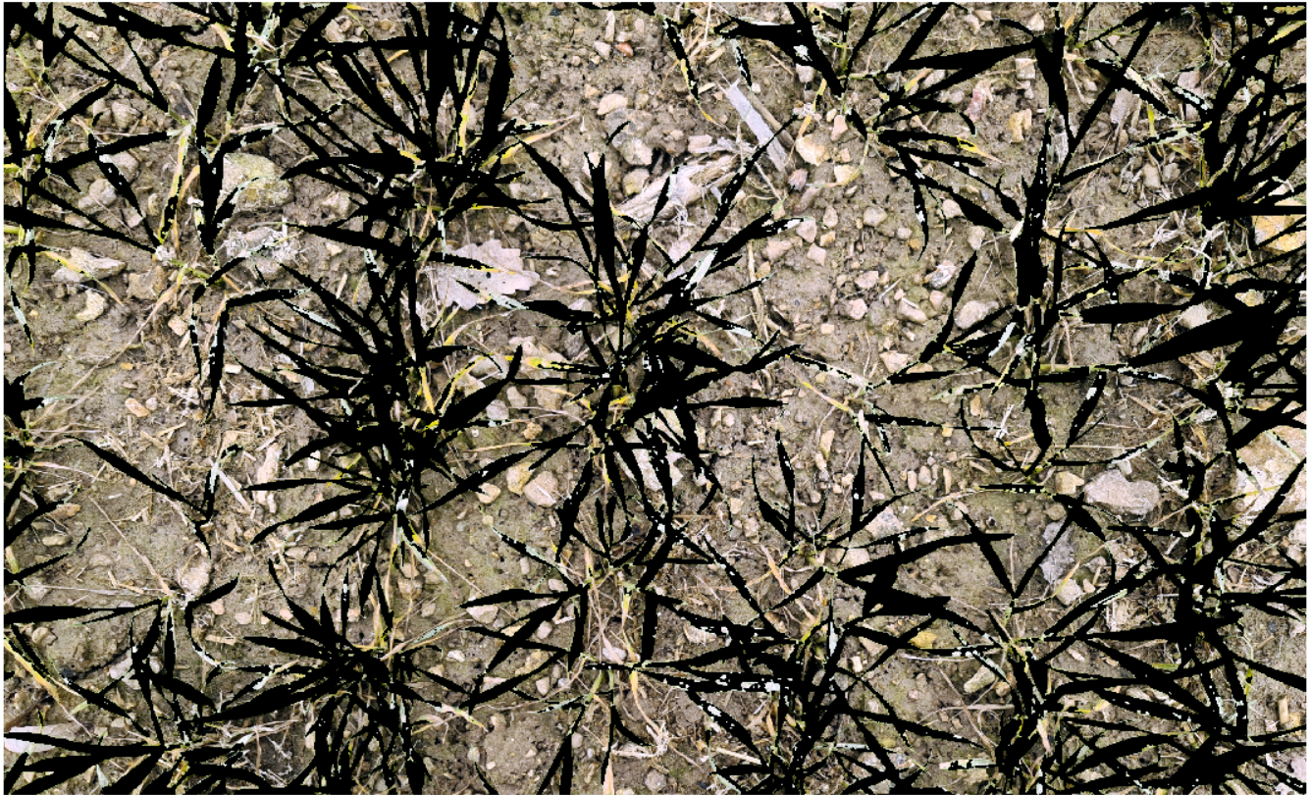
HLS space (Hue Lightness Saturation), 2 crisp clusters (not fuzzy)
By increasing the distance between camera and land, it seems that separating vegetated regions from bare soil is more challenging due to the small size of leaves and shadow effects.
Detected areas as vegetation
Overlaid on RGB

Slide 7
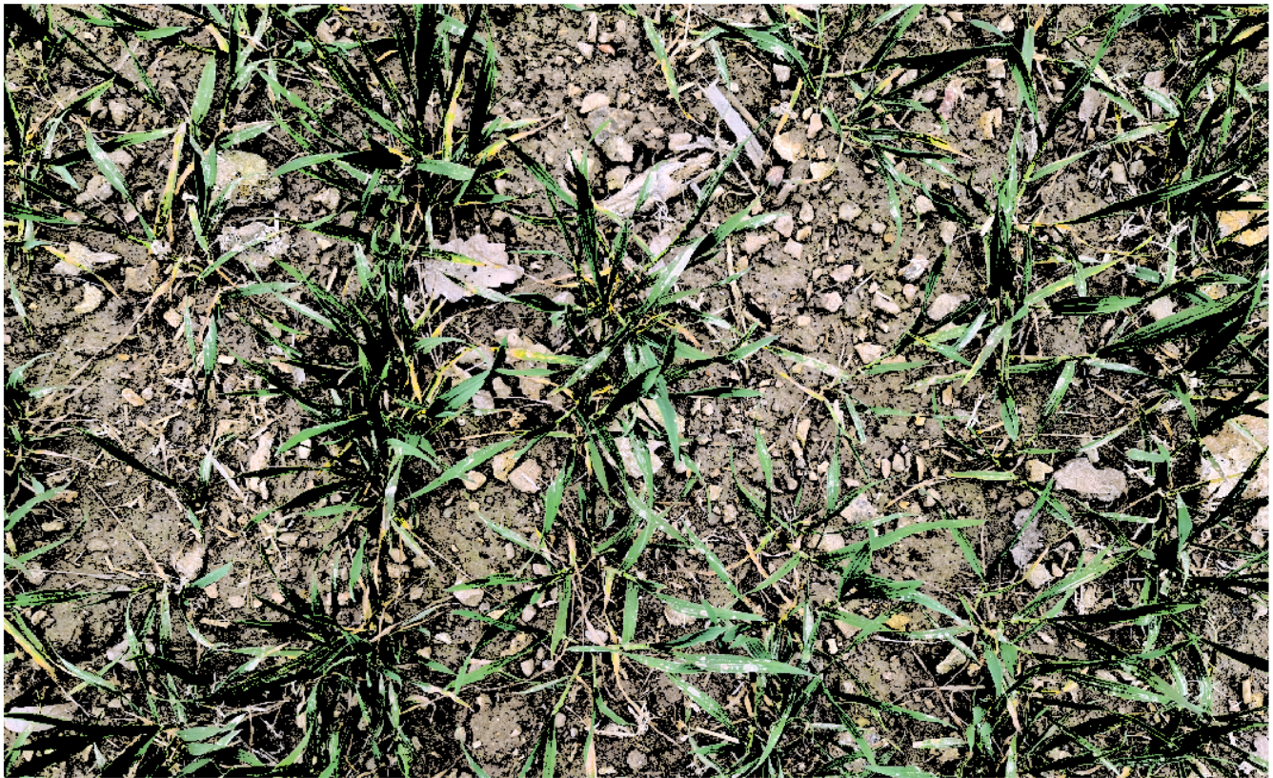
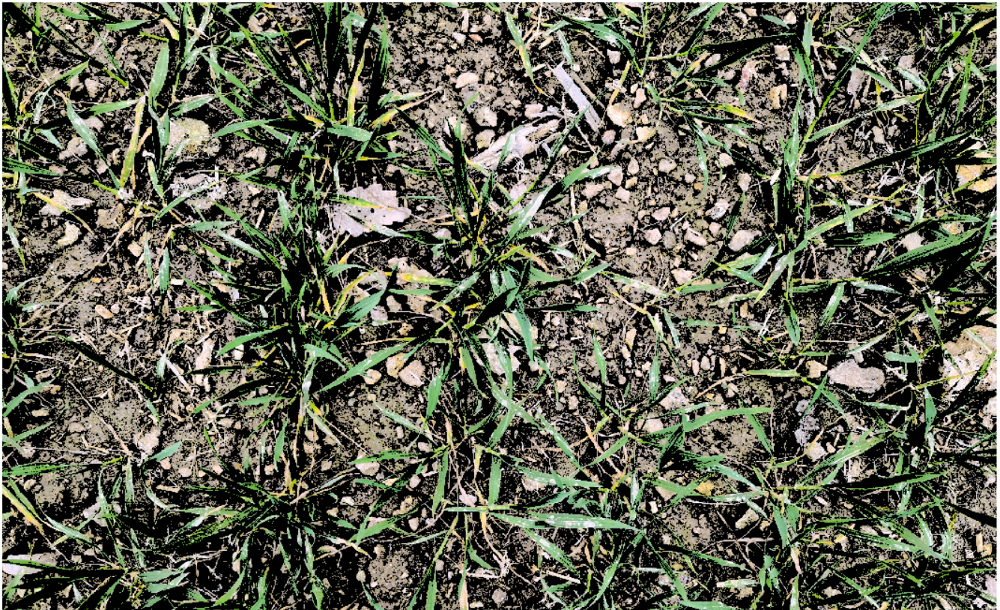
Further Investigations
Two different image spaces:
HSV
YIQ
Low accurate for both cases (near and far distances)
Best choice: HLS
HSV
YIQ

Slide 8
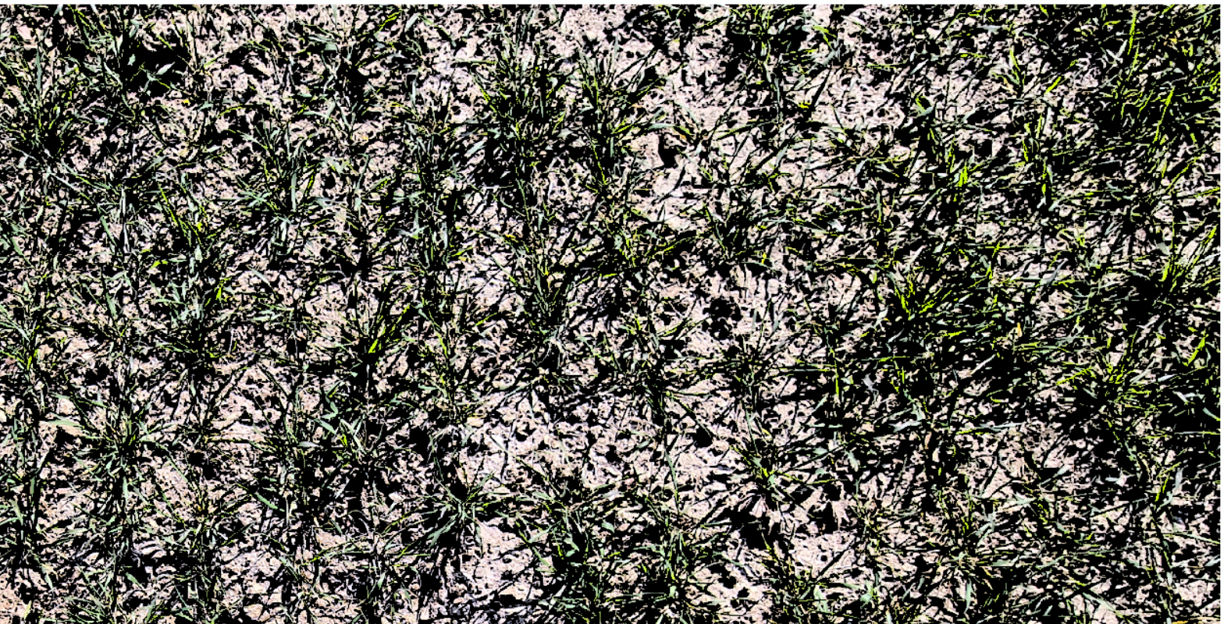
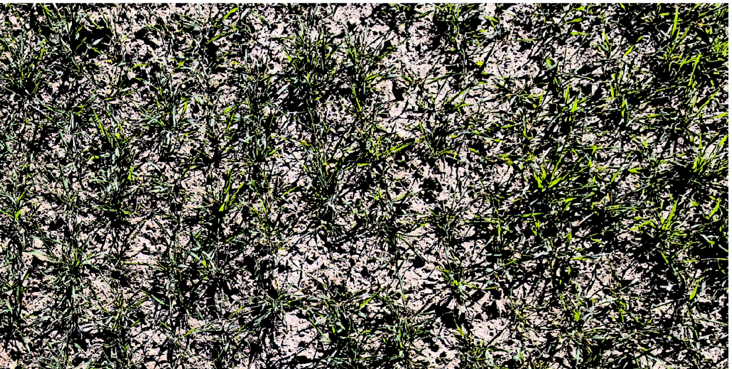
Further Investigations
Two different image spaces:
HSV
YIQ
Low accurate for both cases (near and far distances)
Best choice: HLS
HSV
YIQ

Slide 9
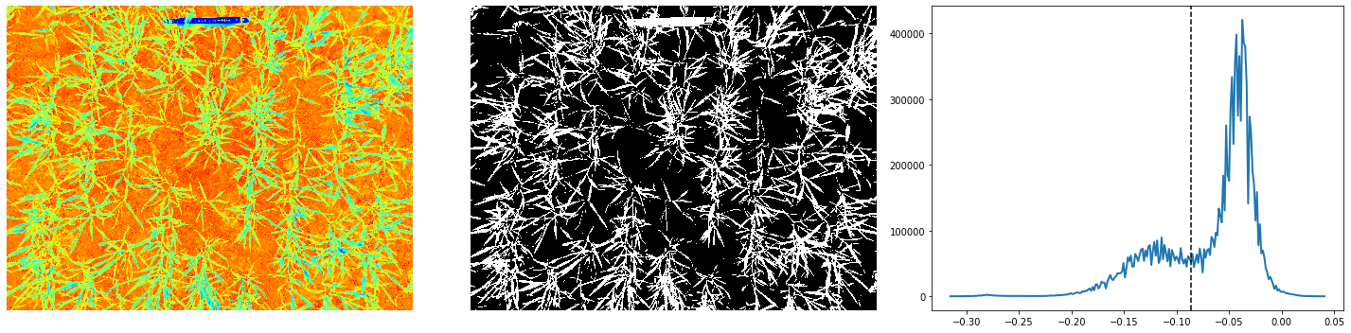
Fuzzy C-means (2 cluster) + Automatic Otsu Thresholding
Otsu Threshold

Slide 10
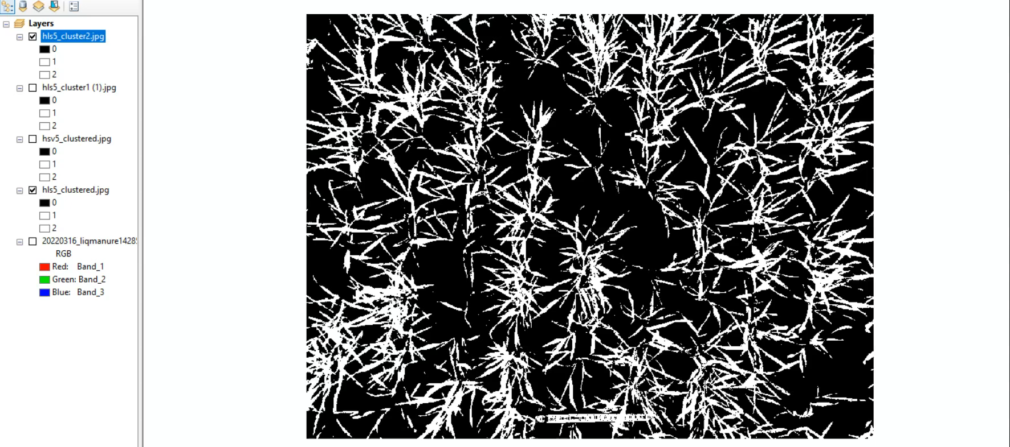
Similar Results of fuzzy c-means to K-means

Slide 11
Further Suggestions
Ensemble clustering of each image:
Consider a pixel as a vegetated area if it is clustered by m out of n clustering results.
What about using Supervised Classification techniques?
What about using Anomaly Detection methods?
Questions
Are shaded areas important to us? Do they lead to any problem?
What is the next step?

